Slide 1

VAAGDEVI ENGINEERING COLLEGE
COMPUTER SCIENCE AND ENGINEERING
AI-POWERED NUTRITION ANALYZER FOR FITNESS ENTHUSIASTS
UG PROJECT PHASE -I
Presented by:
RAMYA SREE KASULA 21UK1A0523
AKHIL BOINAPELLI 21UK1A0521
CHELAMALLA MANIKANTA 21UK1A0559
KOUSHIK BHUKYA 22UK5A0502
Under the Guidance of:
Mr. CH. SHIVASAI PRASAD

Slide 2

AI-Powered Nutrition Analyzer for Fitness Enthusiasts
The AI-powered nutrition analyzer makes tracking your food and nutrition easier. It uses AI to give personalized recommendations and works with fitness apps to help you stay on top of your health.

Slide 3
Problem Statement
Inaccurate Nutritional Tracking
Lack of Personalized Insights
Manual tracking of food intake is prone to errors, leading to inaccurate nutritional analysis and inefficient fitness plans.
Generic fitness recommendations are often insufficient to meet individual needs, hindering progress towards fitness goals.

Slide 4

Proposed Solution
Leveraging AI technology, we propose a novel system that analyzes food intake through image recognition, providing real-time dietary analysis and personalized recommendations tailored to individual fitness goals.

Slide 5
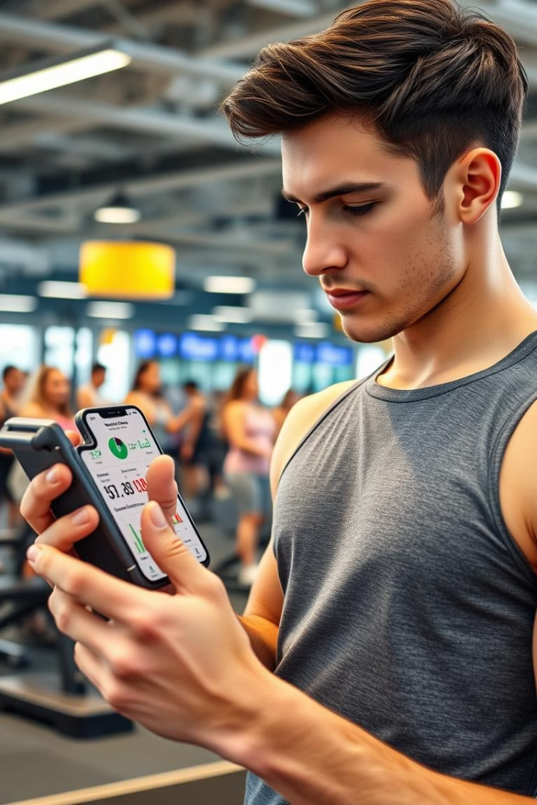
Objectives
1
Simplify Nutritional Tracking
2
Provide Real-time Dietary Analysis
Offer instant feedback on nutritional content, enabling users to make informed dietary choices.
Eliminate the need for manual food logging, streamlining the process of tracking dietary intake.
3
Empower Users with Tailored Fitness Recommendations
Deliver personalized fitness recommendations based on dietary analysis and individual fitness goals.

Slide 6
Methodology
Convolutional Neural Networks (CNNs)
User Profile Integration
Continuous Learning and Progress Tracking
Integrate user profiles and fitness goals to personalize recommendations and track progress.
Utilize CNNs for accurate food image recognition and classification, analyzing nutritional composition.
The system continuously learns from user feedback and adapts recommendations for optimal results.

Slide 7
System Flowchart
Image Upload
1
Users capture images of their meals using their mobile device cameras.
2
Preprocessing
The system preprocesses images to optimize for food recognition and analysis.
Food Classification
3
CNNs identify and classify food items, extracting nutritional information.
4
Feedback and Recommendations
The system provides real-time feedback on nutritional content and personalized recommendations.
Integration with Fitness Apps
5
Seamlessly integrate with fitness trackers to synchronize data and optimize fitness plans.

Slide 8
Key Features
Image-based Food Recognition
Real-time Nutritional Analysis
Personalized Recommendations
Users simply capture images of their meals to receive accurate nutritional analysis.
Instant feedback on macronutrients, calories, and other key nutritional factors.
Tailored advice on dietary adjustments and fitness plans based on individual needs.
Integration with Fitness Trackers
Progress Tracking and Feedback
Seamlessly connect with fitness trackers to synchronize data and provide comprehensive insights.
Monitor progress over time and receive personalized feedback to stay motivated and achieve goals.

Slide 9
System Architecture
Hardware Design
Software Design
User device: Camera and mobile processor for image capture and data processing.
Mobile/Web application: User interface for image upload, data visualization, and interaction.
Cloud-based servers: For model execution, data storage, and API management.
Backend: API endpoints for communication with the user interface, model, and cloud storage.
Optional IoT integration: Smart scales, wearable devices, and other connected devices.
Deep Learning Model: Developed using TensorFlow/PyTorch, trained on food image datasets.

Slide 10
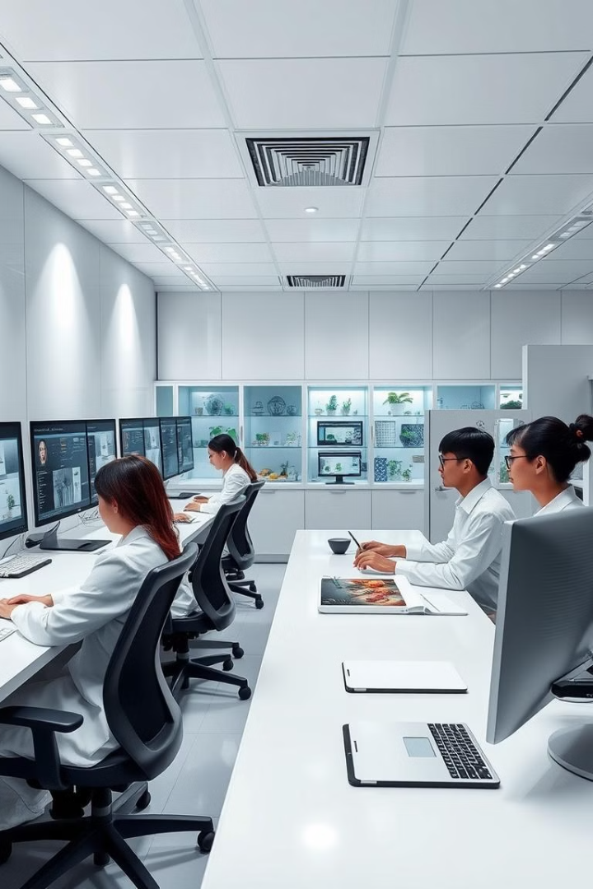



Experimental Investigations
Model Accuracy Testing
Real-time User Trials
Evaluation of model accuracy using comprehensive food datasets, ensuring reliable nutritional analysis.
Conducting usability studies with real users to assess system performance and user experience.
Integration with Fitness Trackers
Testing and validating integration with popular fitness trackers for seamless data synchronization.

Slide 11
Future Scope
1
Enhanced Food Databases
2
Integration with Wearable Devices
Expanding the database with more diverse food items and detailed nutritional information.
Seamlessly integrating with wearable devices to provide comprehensive health insights.
3
Real-time Meal Preparation Assistance
4
Advanced Personalization Using IoT and AI
Offering real-time guidance and suggestions during meal preparation.
Leveraging IoT and AI for personalized recommendations based on individual preferences and health data.

Slide 12
Benefits
1
Simplifies Dietary Management
2
Provides Data-Driven Insights
3
Encourages Healthy Eating Habits
Effortlessly tracks macronutrients, calories, and other nutritional factors.
Offers personalized recommendations for dietary adjustments and fitness plans.
Promotes mindful eating and helps users make informed food choices.

Slide 13
Challenges
Diverse Food Datasets
Scalability and Security
User Engagement
Handling a wide variety of food items with different shapes, sizes, and appearances presents a significant challenge for model accuracy.
Ensuring the system can handle a large number of users and their data while maintaining data privacy and security is critical.
Maintaining user interest and motivation over time requires a user-friendly interface and engaging features.

Slide 14
Technologies Used
Deep Learning Frameworks
Cloud Platforms
Development Languages
AWS and Google Cloud provide scalable infrastructure and services for hosting the application, data storage, and model deployment.
Python and JavaScript are employed for developing the backend API, user interface, and seamless integration with other platforms.
TensorFlow and PyTorch are used for building and training the deep learning model, enabling accurate food recognition and nutritional analysis.

Slide 15
References
IEEE, Elsevier, and Springer publications on AI and nutrition
Relevant tools and frameworks for development

Slide 16
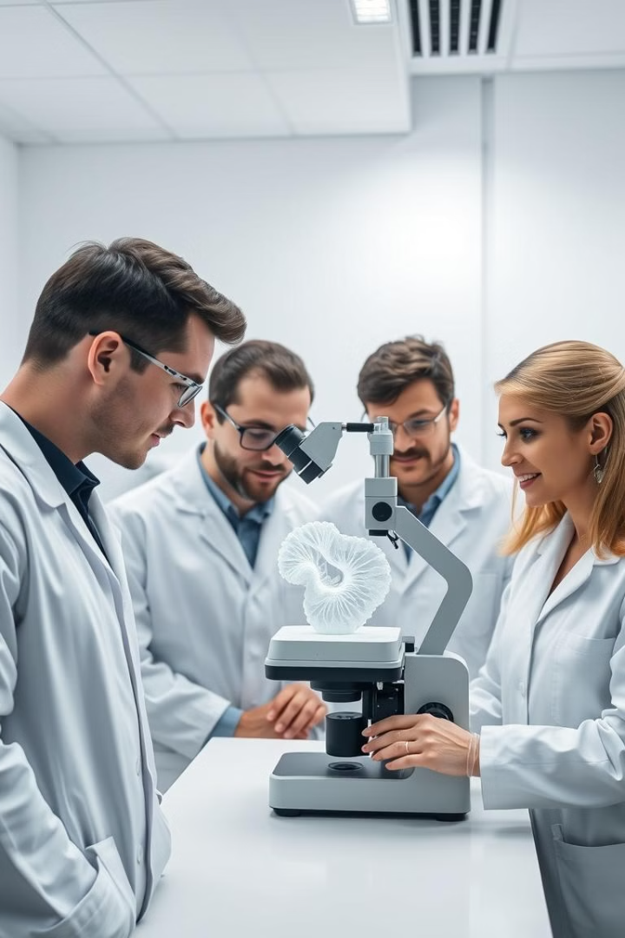
Conclusion
The AI-Powered Nutrition Analyzer helps people track their food and reach health goals easily. It uses AI to recognize food and give personalized suggestions. It connects with fitness apps and gives useful insights to help people live healthier lives.
This system makes tracking food smarter and could improve even more with features like wearable devices and real-time meal help.

